Slide 1

Sentiment Analysis on the Amazon Reviews Dataset
Andrew Bauman and Allison Nowakowski

Slide 2
Original Data Columns
Marketplace
Customer_id
Review_id
Product_id
Product_parent
Product_title
Product_category
Star_rating
Helpful_votes
Total_votes
Vine
Verified_purchase
Review_headline
review _body
review_date

Slide 3
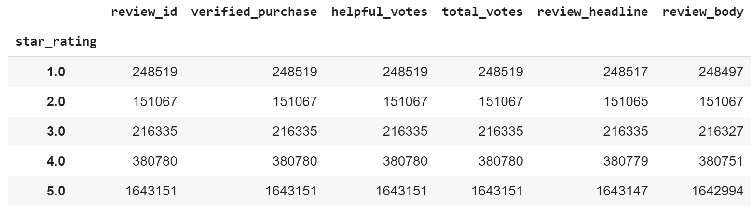
View of Data

Slide 4
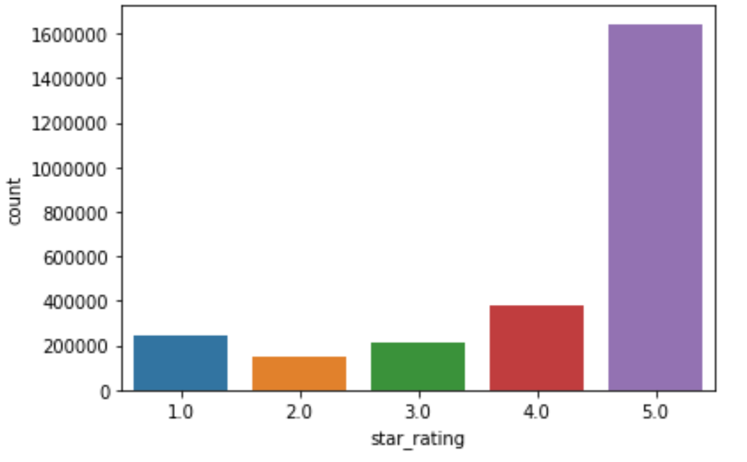
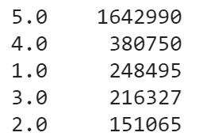
Number of Ratings

Slide 5
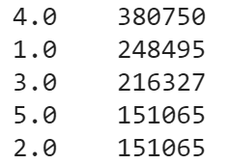
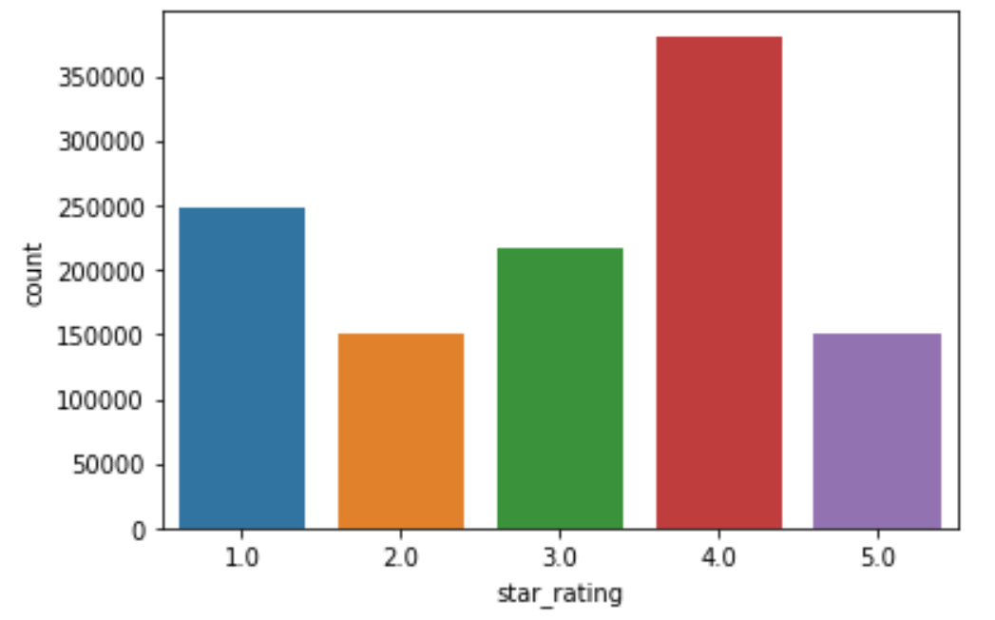
Downsampled Data

Slide 6
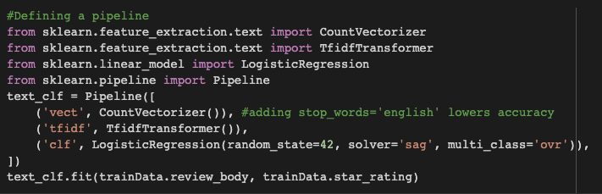
Our Fine-Grained, Sentiment Analysis Model

Slide 7
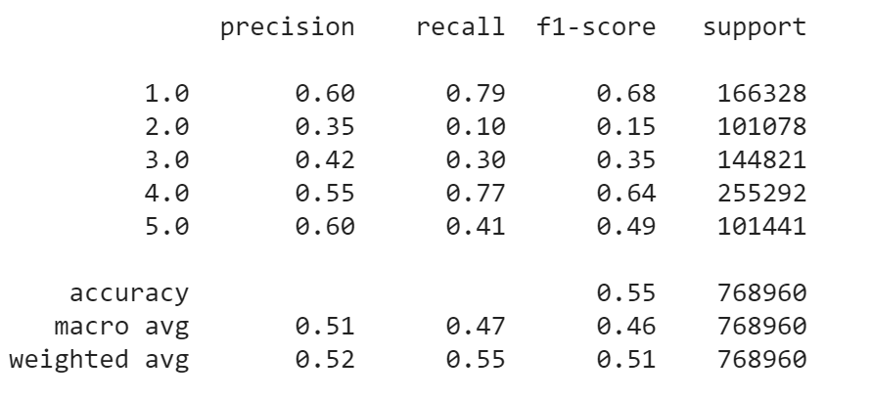
Results

Slide 8
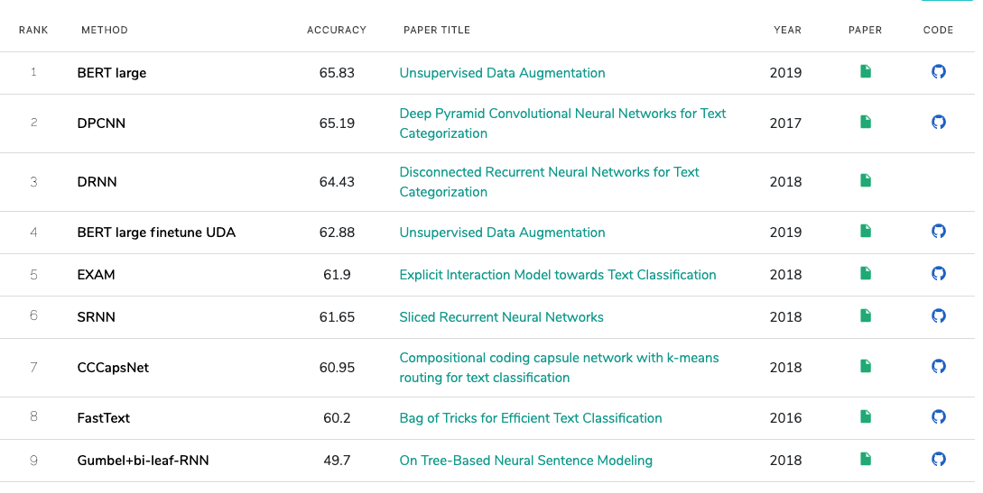
Comparing Results to State-of-the-Art Methods
Source: paperswithcode.com

Slide 9
Thank You
Any Questions?

